Slide 1



Slide 2

Today’s objectives
Why go to University?
What types of people will you meet at University?
Student life
Choosing subjects
Brandon’s journey – GCSE -A-Level/Btec – Liverpool – post grad

Slide 3
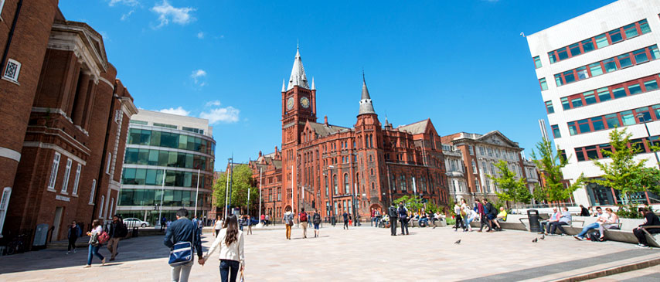
What is University?
Notes:
So you’ve all experienced primary school, secondary school. Your next educational step is either Sixth Form or College, and the final step after that is University!
University is like school in the sense that you learn, but it’s much much different. For example…

Slide 4
You can study what you want
More than 1000 subjects
Notes:
So in school you’re forced to learn a few subjects some of you may not like. English, Maths, Sciences. At University YOU pick what you want to study. There are over 1000 different academic subjects you can choose from!
https://en.wikipedia.org/wiki/Outline_of_academic_disciplines

Slide 5
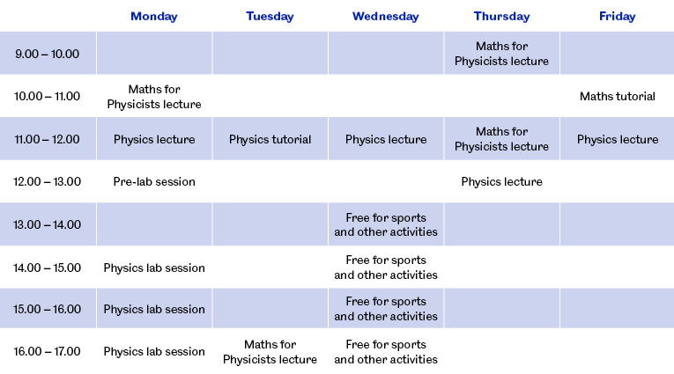
You choose when to study (kind of)
Notes:
At school, you’re told to be in from 9am to 5pm and you have to attend lessons at strict times at strict places. At University, you’re given classes you can go to but if you’re first class is at 4pm you can just stay at home all day until 4pm, in fact a little known secret is that most lectures aren’t compulsory. If you want a day off on Friday you can just take a day off, no one is going to tell you off or call you out on it.
Here’s an example timetable. So you come into university at 10am (you don’t have to be in until your first lecture, so yes you can wake up at 9:30am and go to university!)
At most universities Wednesday evenings are reserved for sports, but if you don’t take part in a spot you have all of that time off!
Notice how you only have to be in on Tuesday for 2 hours. You can come into university at 11, go home at 12 and come back at 4pm! Unlike school where you come in at 9am and if you have a free period you still have to be in school, you can go home!!

Slide 6

Why go to University?
Notes:
What do you think? Why should you bother going to university? Ask the audience this question.
** NOTE TO READER
This is an animated slide. Press mouseclick to open up a wordcloud.

Slide 7

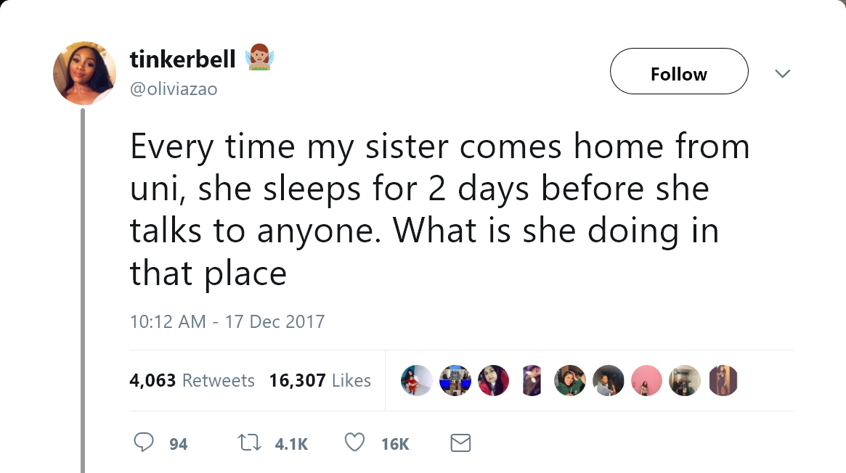
What is a typical student?
Notes:
Not many people understand what a typical student is. Is it someone who clearly doesn’t get enough sleep at university because they’ve been partying too much or working on an assignment all night?

Slide 8
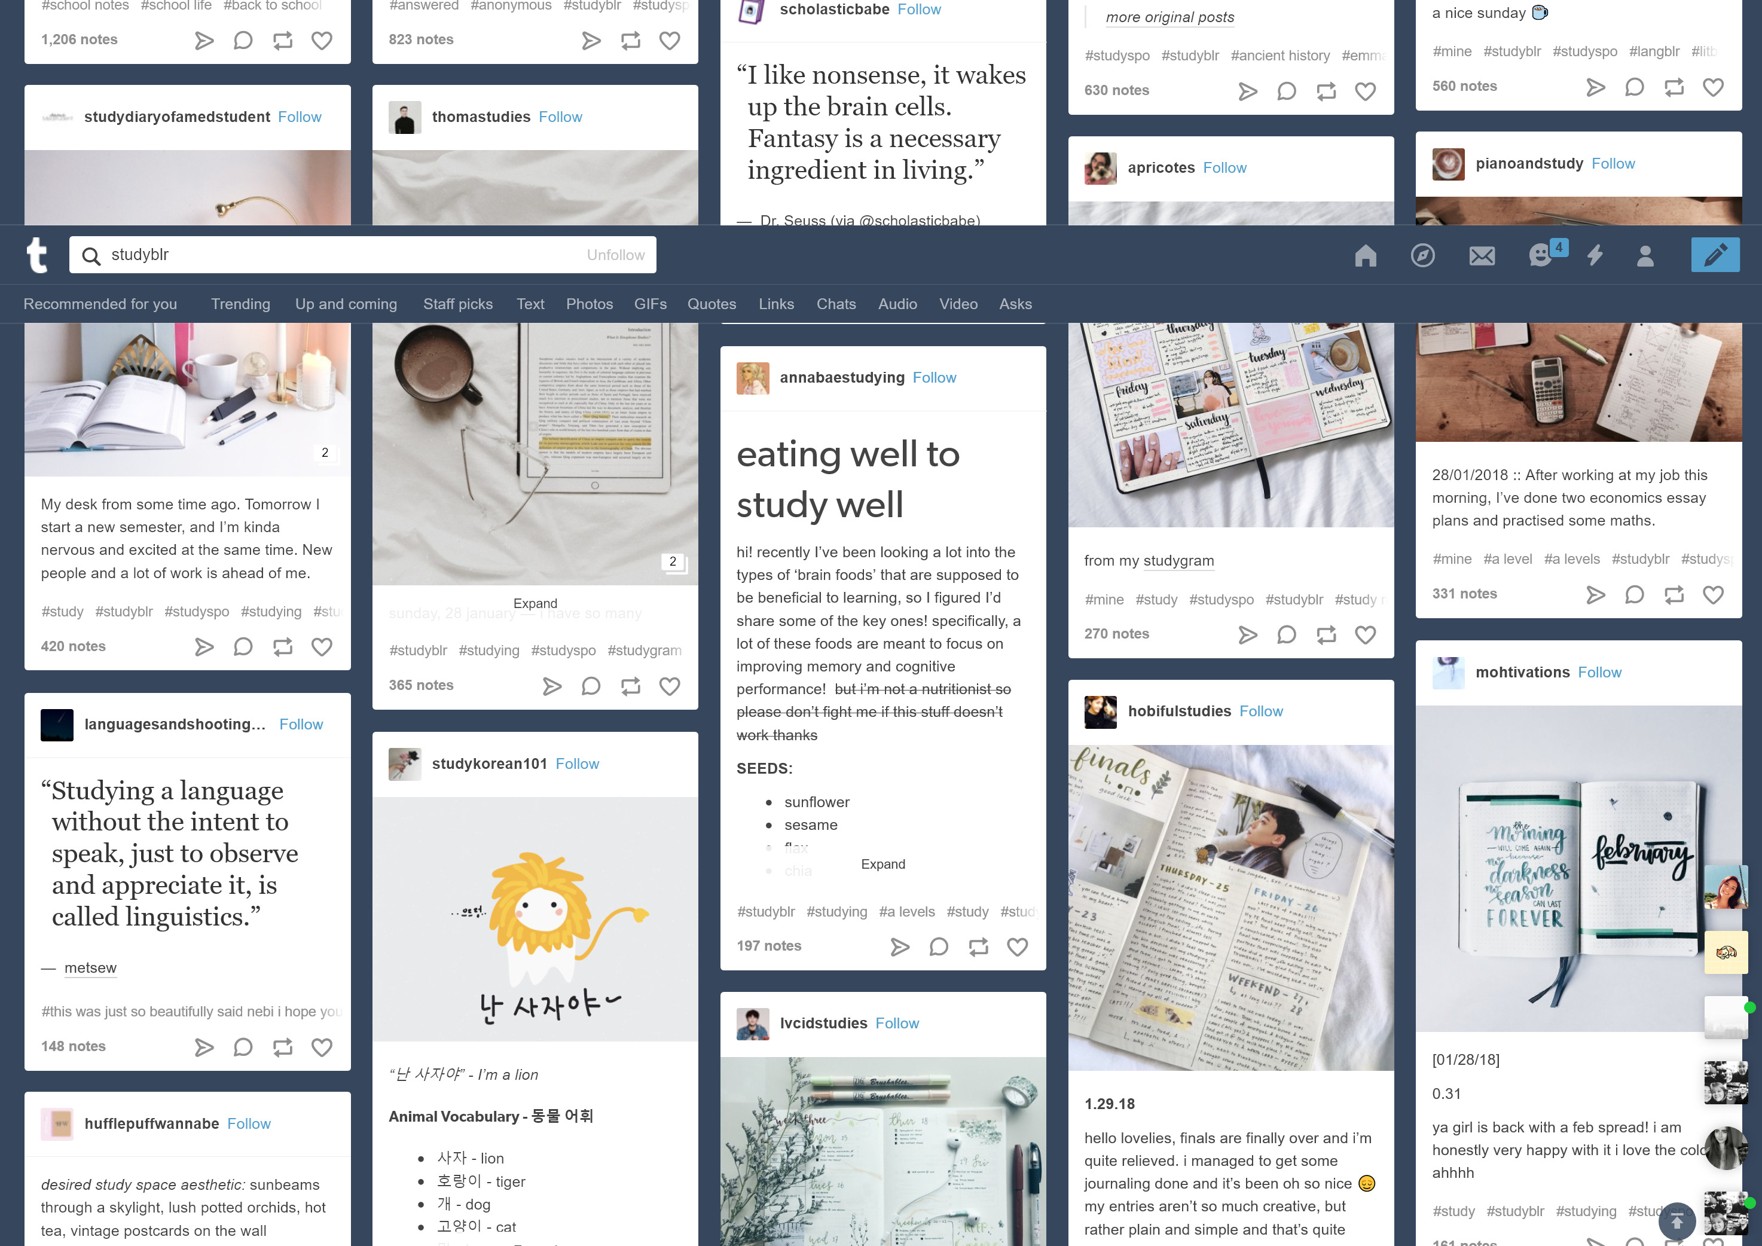

What is a typical student?
Notes:
Is it creating elaborate study methods to make sure you pass your exams?

Slide 9
Well, actually, it’s a bit of both
Notes:
Put google photos movie here

Slide 10

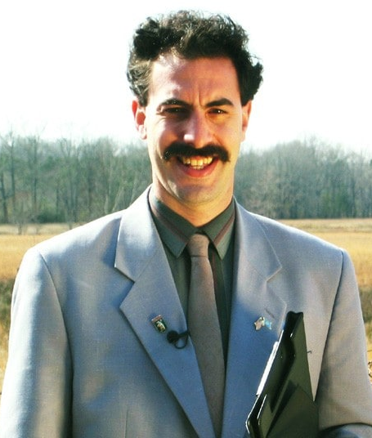
Just Stereotypes
Degree in 3d Digital Design
Degree in history from Cambridge
JME – Grime Artist
Sacha Baron Cohen
Borat / Bruno
Notes:
This should be interactive – the arrows appear when you click the mouse. Also, I included Frank Lampard as some of the kids have said in the past that they want to be a footballers, I believe he shows that you can still enjoy and do well in school, as well as want to play football.

Slide 11

The Guild of Students
Notes:
Imagine a big part of the university run by students for students. Wouldn’t you like your school to have adorable puppy petting days, ice cream days or actually cool school trips? Well, this is exactly what the guild is.
A big part of the guild is socities, you might call these clubs. If you like dungeons and dragons, archery, karate, literally anything you can think of there is a socitiey that lets you partake in this.

Slide 12
University of Liverpool True or False?
University of Liverpool is 135 years old.
True or False?
Over 20,000 students study at the University of Liverpool.
True of False?
University libraries are open from 9AM till 5PM Monday to Friday.
True or False?
You can study more than 100 subjects at the University of Liverpool.
True or False?
Liverpool has the most part-time student jobs in the UK
True or False?
Notes:
TRUE
TRUE
FALSE
TRUE
TRUE

Slide 13
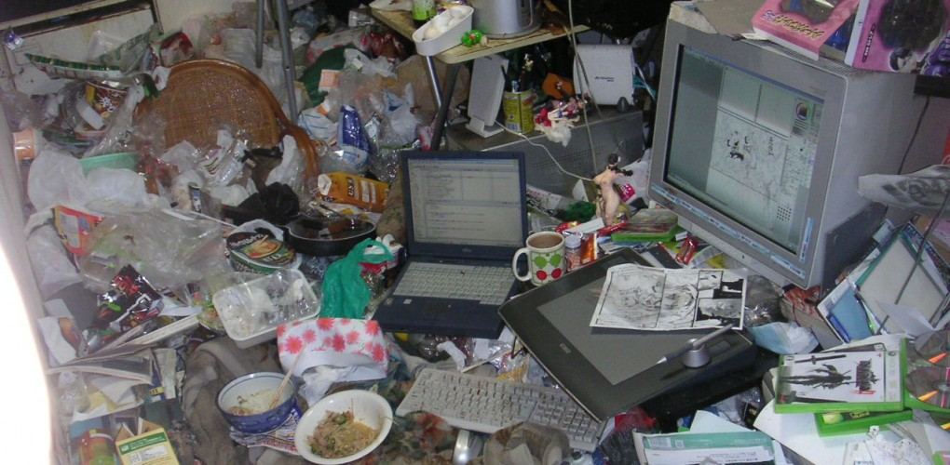
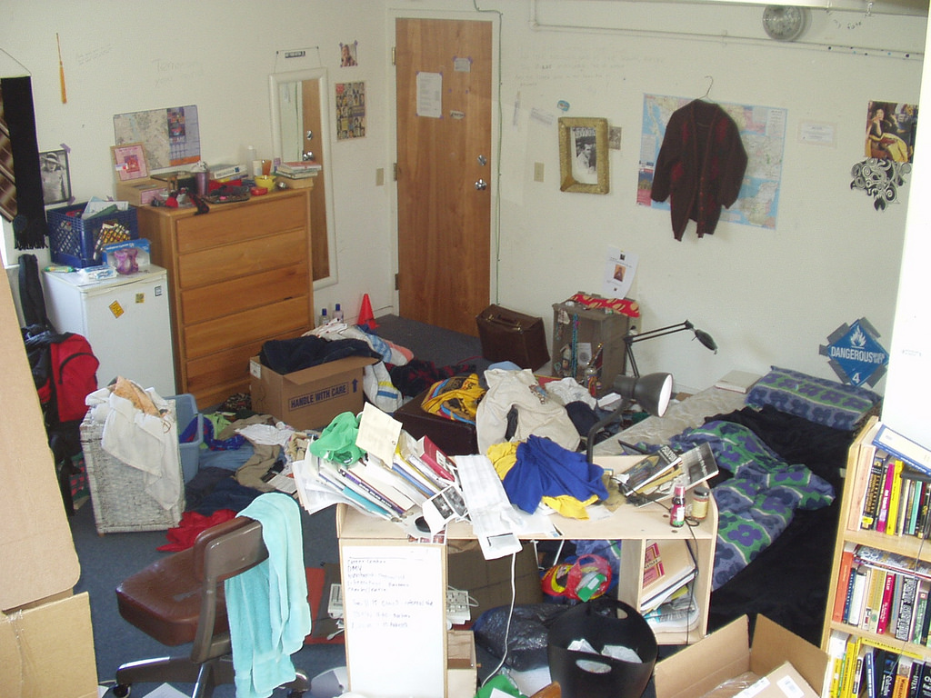
Student Life: Accommodation
Notes:
So, accommodation. The big question. Some people may think students live in a mess like this,

Slide 14
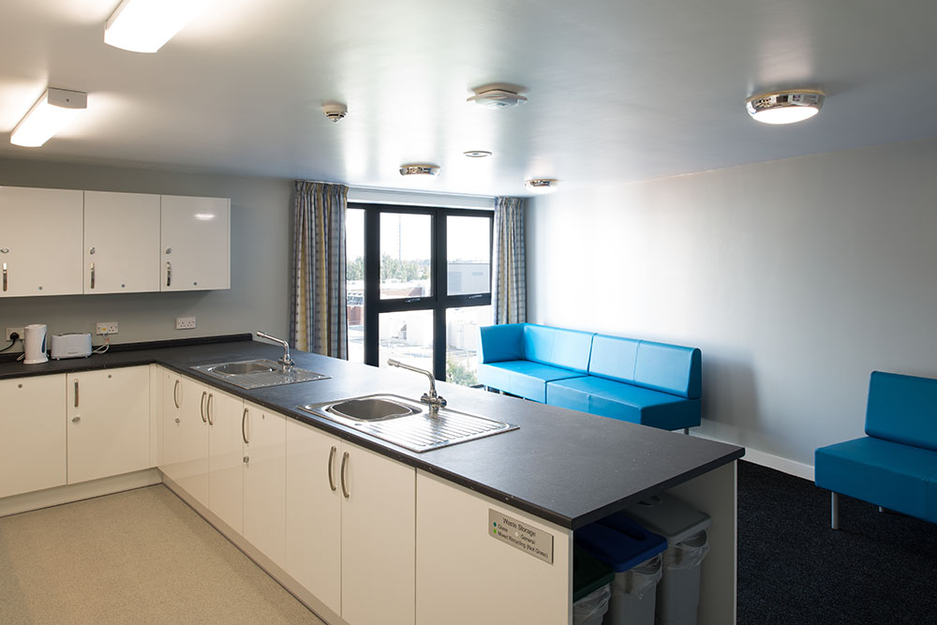
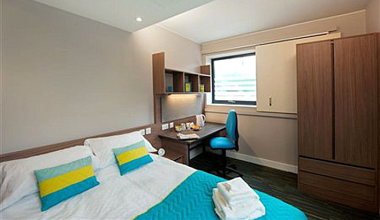
Student Life: Accommodation
What do the Students think?
‘There is a very social atmosphere about halls. There is always something going on and lots of people to meet and talk to.’
Lilly Moore, Student at Carnatic Village 2015-2016
Notes:
So these two photos are from Vine Court and Crown Place. You won’t be living in some dirty old run down building, you’ll be living in high quality student accommodation.

Slide 15
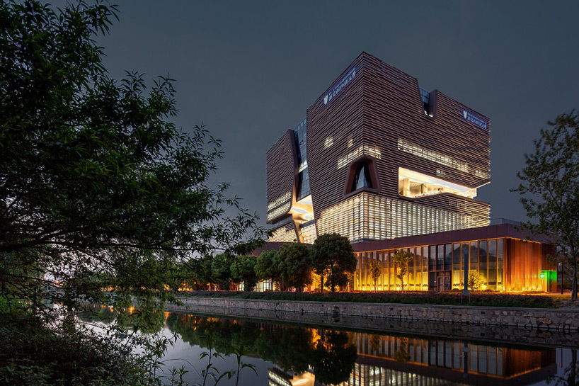

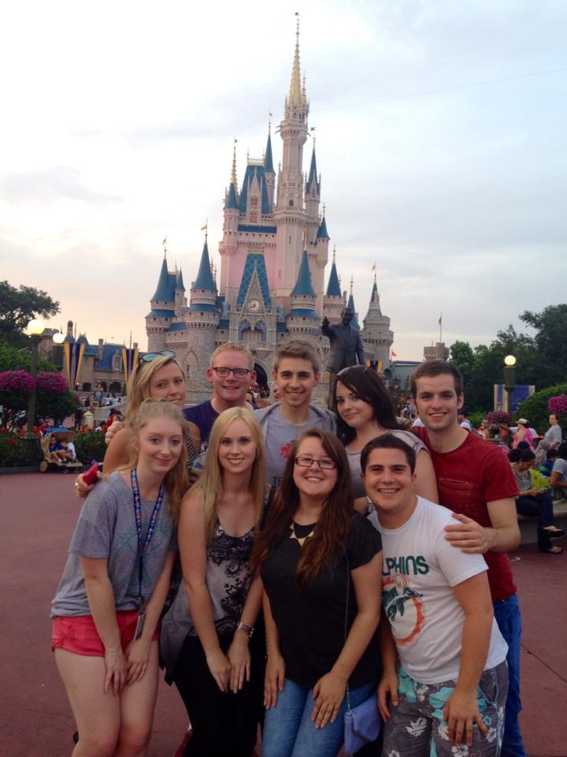

Student Life: Travel
Year abroad
Xi'an Jiaotong-Liverpool University
Disney College Programme
Notes:
Pronounced x-iron Jean-an-tong university

Slide 16


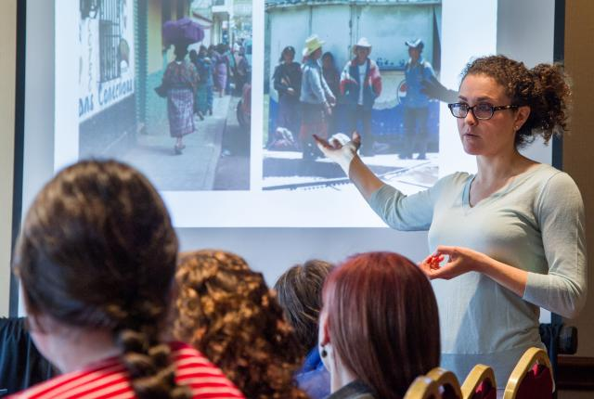
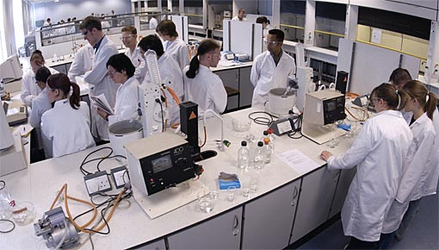

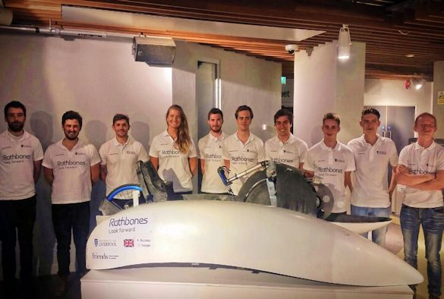
Student Life: Studying and Types of Assessment
Essays/coursework
Exams
Presentations
Labs
Group work
Practical work
Notes:
Talk about what its like in school vs what its like in uni. Not much difference.

Slide 17
“Facilitating” Subjects
These subjects are the most useful
When applying to the University of Liverpool
Combine with other subjects you are interested in
Maths & Further Maths
Biology
Chemistry
History
Psychology
English
Physics
Modern and Classical Languages
Notes:
http://russellgroup.ac.uk/for-students/school-and-college-in-the-uk/subject-choices-at-school-and-college/
Source ^^

Slide 18

University True or False?
You need Maths and English GCSE to go to University.
True or False?
To study a subject at University you must have studied it at A-Level or BTEC.
True or False?
When you go to University, you have to move away from home?
True or False?
Those who have been to university earn £12,000 per year more on average than those who haven’t been (amounts to £500,000 more over lifetime).
True or False?
Notes:
TRUE
FALSE
FALSE
TRUE

Slide 19


How much could you earn?
Over your lifetime you can earn £170,000-£250,000 more if you have a degree. £10,000 extra a year!
Who earn the most? STEM, medicine, law, economist graduates- double creative art graduates
Choose your university well- Russell Group university
graduates earn 40% more than graduates from other
universities.
The Average starting salaries for Graduates in the NW is £27,401, whilst for STEM graduates it is £30,000.
Notes:
On a side note if you want to move out of the UK to a STEM hotspot such as San Francisco your minimum starting salary is £45k
Sources:
http://www.huffingtonpost.co.uk/entry/silicon-valley-salaries_us_56d61ee6e4b0bf0dab33ce96
http://uk.businessinsider.com/what-people-say-about-making-120000-in-silicon-valley-2016-6
https://qz.com/766658/the-highest-paid-workers-in-silicon-valley-are-not-software-engineers/

Slide 20

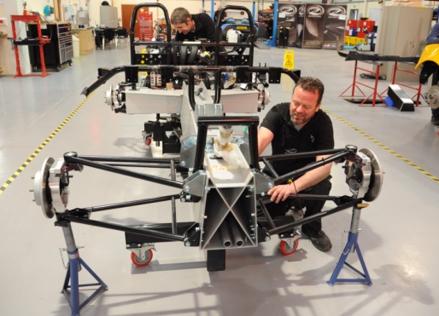
Where can I go with my degree?
Advanced Manufacturing- Jaguar or Land Rover
Digital and Creative- Develop health technology, Game Development
Financial and Professional- Financial Technology
Health and Life Sciences- eHealth companies
Superport or Low Carbon- Liverpool Docks
Visitor Economy- Tourism in Liverpool

Slide 21
Is your degree your life?
Once you pick a degree, do you stay in that field forever?
Notes:
So some of you may think that once you pick a degree, that’s it. That is your life. You can’t ever do anything different. Once you study geology you are a geologist for life. Well, contrary to popular belief this isn’t true.

Slide 22
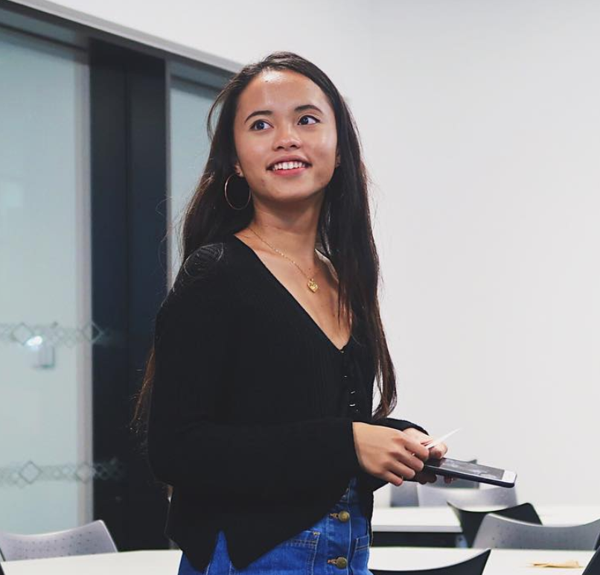
Meet Pauline
Programming since 2008
Web Developer at Sheffield University
Community Builder for Code First Girls & Hack Med UK & Women in Tech
Fitness guru, blogger and vlogger
Notes:
So this is Pauline! She’s been programming since 2008, she’s a web developer at her university, she’s a community builder for 3 massive technology companies, she’s a fitness guru, blogger & vlogger. So you would expect her to study something like programming at university right? Well, actually she studies Biomedical Science. So even though she studies something completely different from programming she still works as a programmer. You do not have to stay in the field you choose forever!!

Slide 23
Meet Luis
“Switching courses was extremely easy. I literally went into reception and signed a form and it was done.”
Notes:
Luis switched from

Slide 24
Your journey
GCSE – A-Level – Uni - post grad - Brandon
Loads of pics in!

Slide 25
summary
Benefits of university
Summary of Liverpool – what you like about UofL?

